Slide 1

Guess The Elo
Can a chess player’s Elo rating be guessed after watching one of their games?

Slide 2
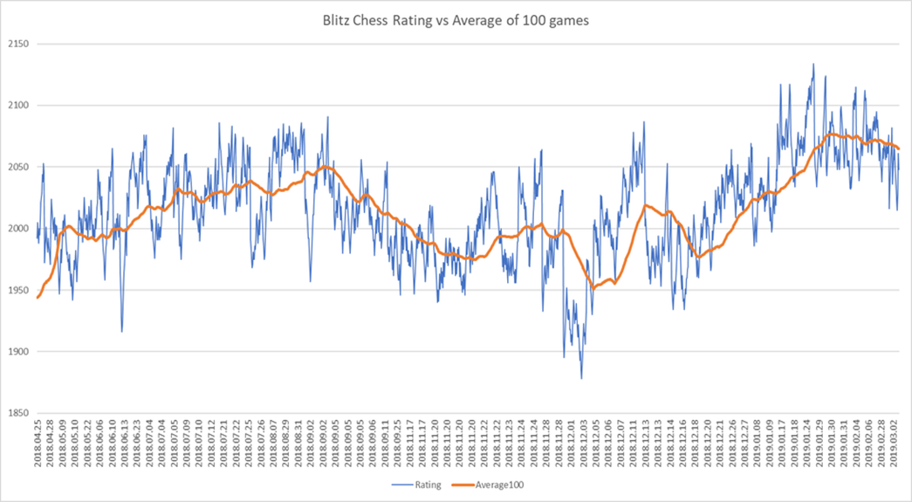
Introduction
Elo rating – estimates a chess player’s strength based on their performance in previous games
Player’s rating will go up after a win and down after a loss
https://www.reddit.com/r/chess/comments/ax30ky/a_graph_showing_lichess_blitz_chess_rating_vs/

Slide 3
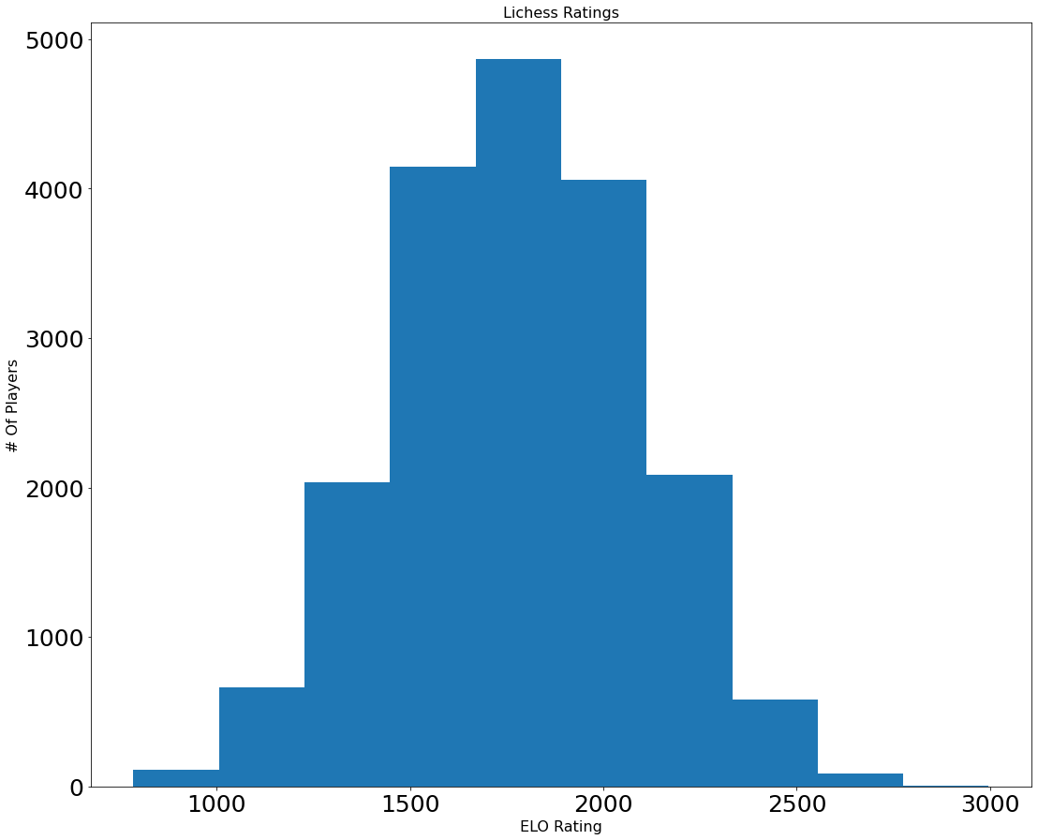
Introduction
Different ratings are used on different websites
On chess site lichess.org, ratings range from about 800 to 3000
800 is extremely bad
3000 is best in the world
Ratings are normally distributed

Slide 4
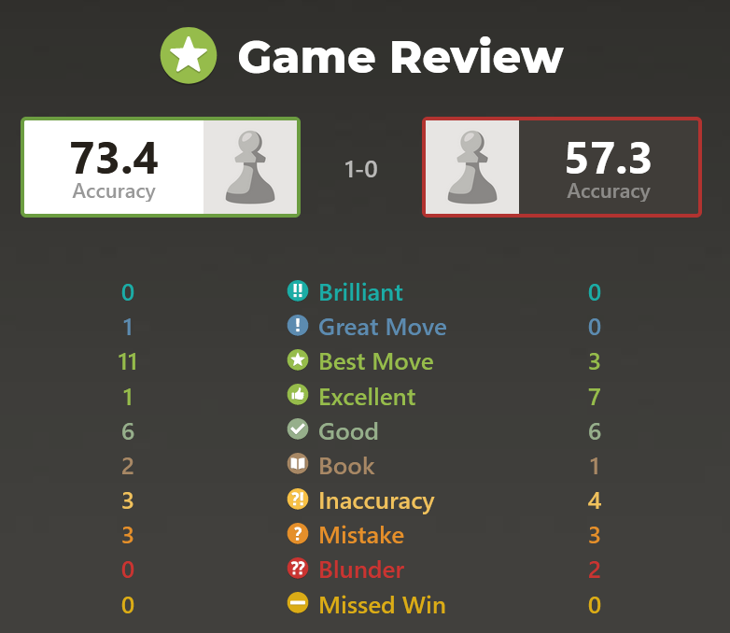
Introduction
Game of chess
After an online chess game is played, stats about the game are produced:
Number of inaccuracies
Number of mistakes
Number of blunders
Number of book moves
Goal is to use these stats to try to predict a player’s rating after watching one of their games
Post-game stats

Slide 5
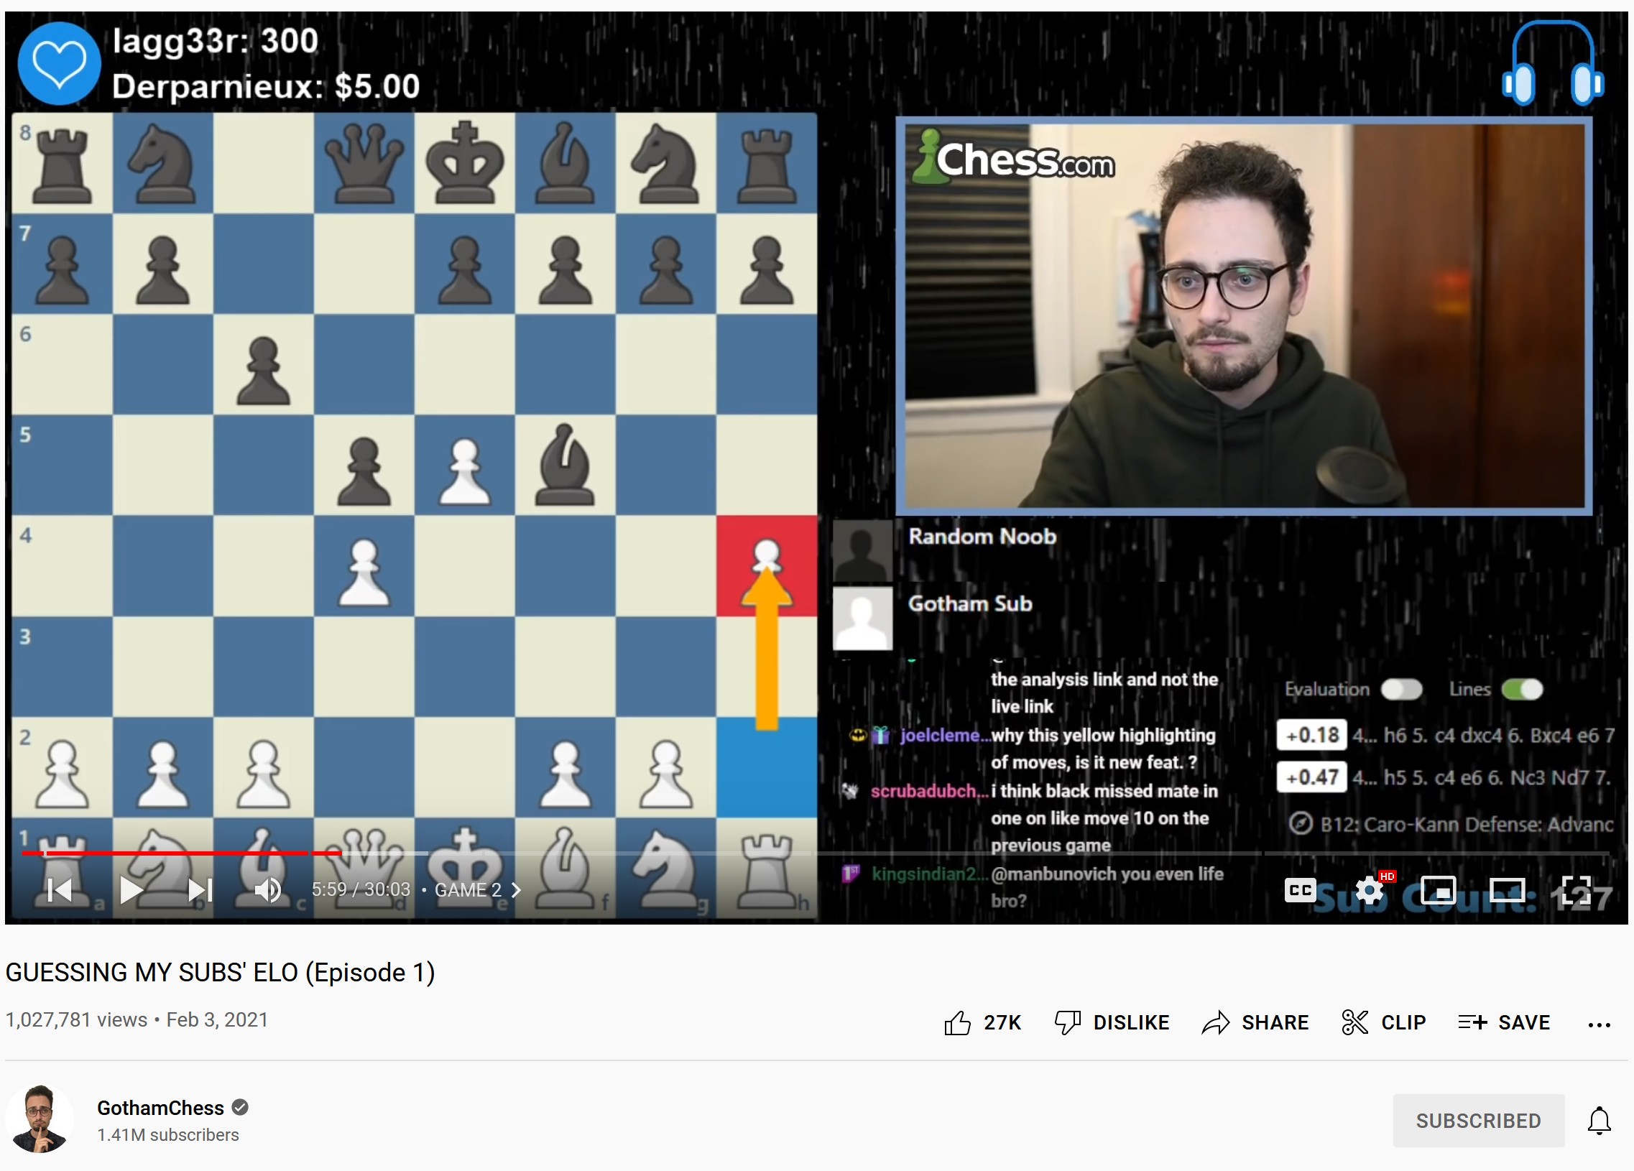
Introduction
Based on popular YouTube series “Guess The Elo” by GothamChess
Can also try guessing ratings yourself on eloguessr.com

Slide 6
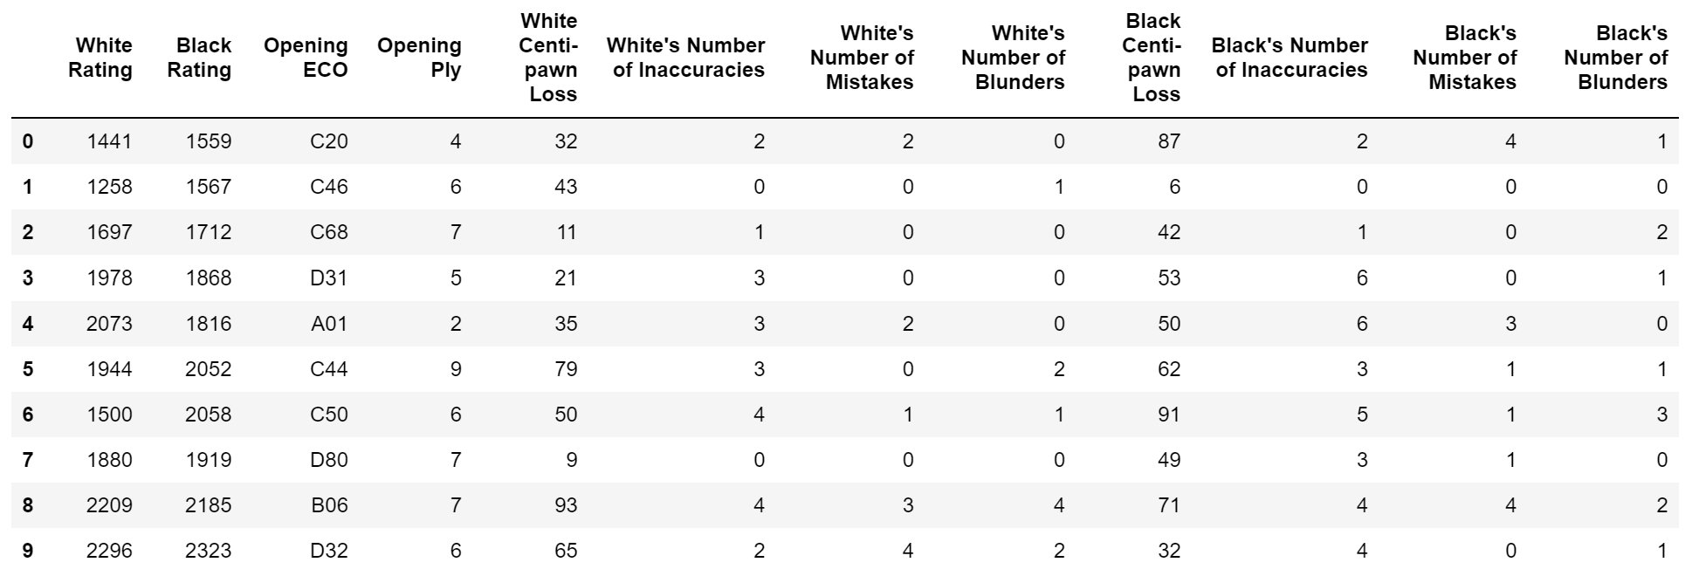
Data
Gathered from 18637 games played on lichess.org
Target: White Rating
Initial features: everything except white and black ratings

Slide 7
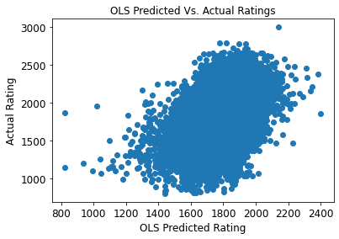
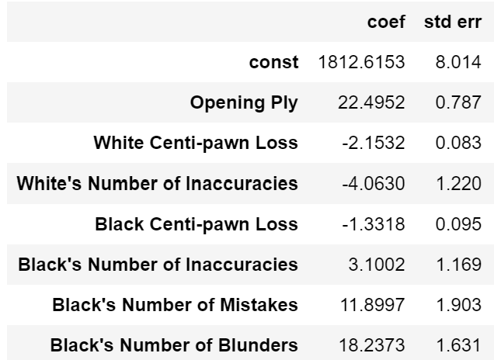
Training Model 1) Ordinary Least Squares
Variation explained by the model: 16.0%
Statistically significant features:

Slide 8
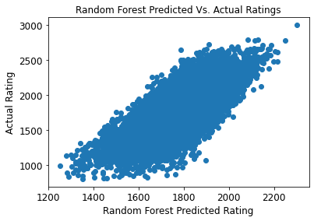
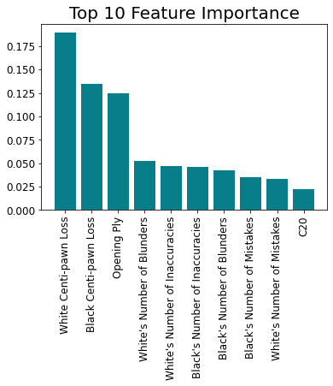
Training Model 2) Random Forest
All features included
Variation explained by the model: 19.2%

Slide 9
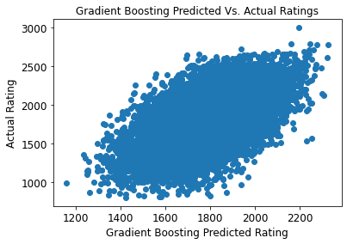
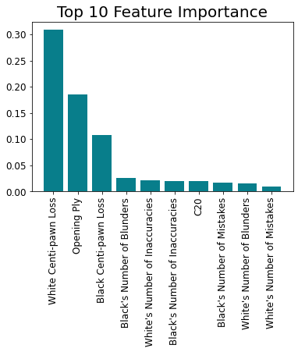
Training Model 3) Gradient Boosting
All features included
Variation explained by the model: 30.9%

Slide 10
Predictive Ability Of The Models
 | R-squared | Mean Squared Error
OLS | 0.154 | 84551
Random Forest | 0.186 | 81270
Gradient Boosting | 0.213 | 78631
Applied trained models to the test data
Gradient boosting model is the best choice
Low r-squared suggests accurately predicting ratings after watching one game is difficult to do

Slide 11
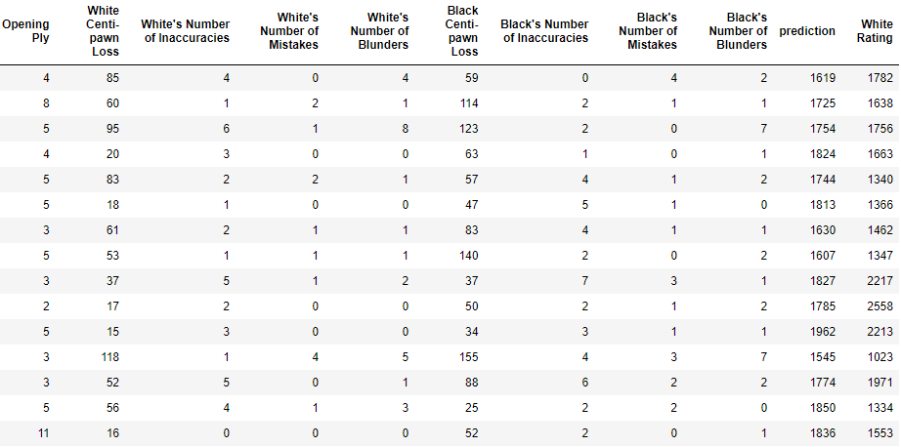
Gradient Boosting Model In Action
Converted predictions to integers and removed openings columns for clarity

Slide 12
Summary
Difficult to predict chess players’ ratings
Difficulty in predicting adds to the fun
Adds element of shocking “I never would have guessed that” moments
From an improving in chess perspective, Centi-pawn Loss and Opening Ply were most important features
Minimize mistakes throughout the game
Specific opening does not matter, but knowing the theory behind the chosen opening does

Slide 13

Questions?

Slide 14
Thank You!

